Slide 1
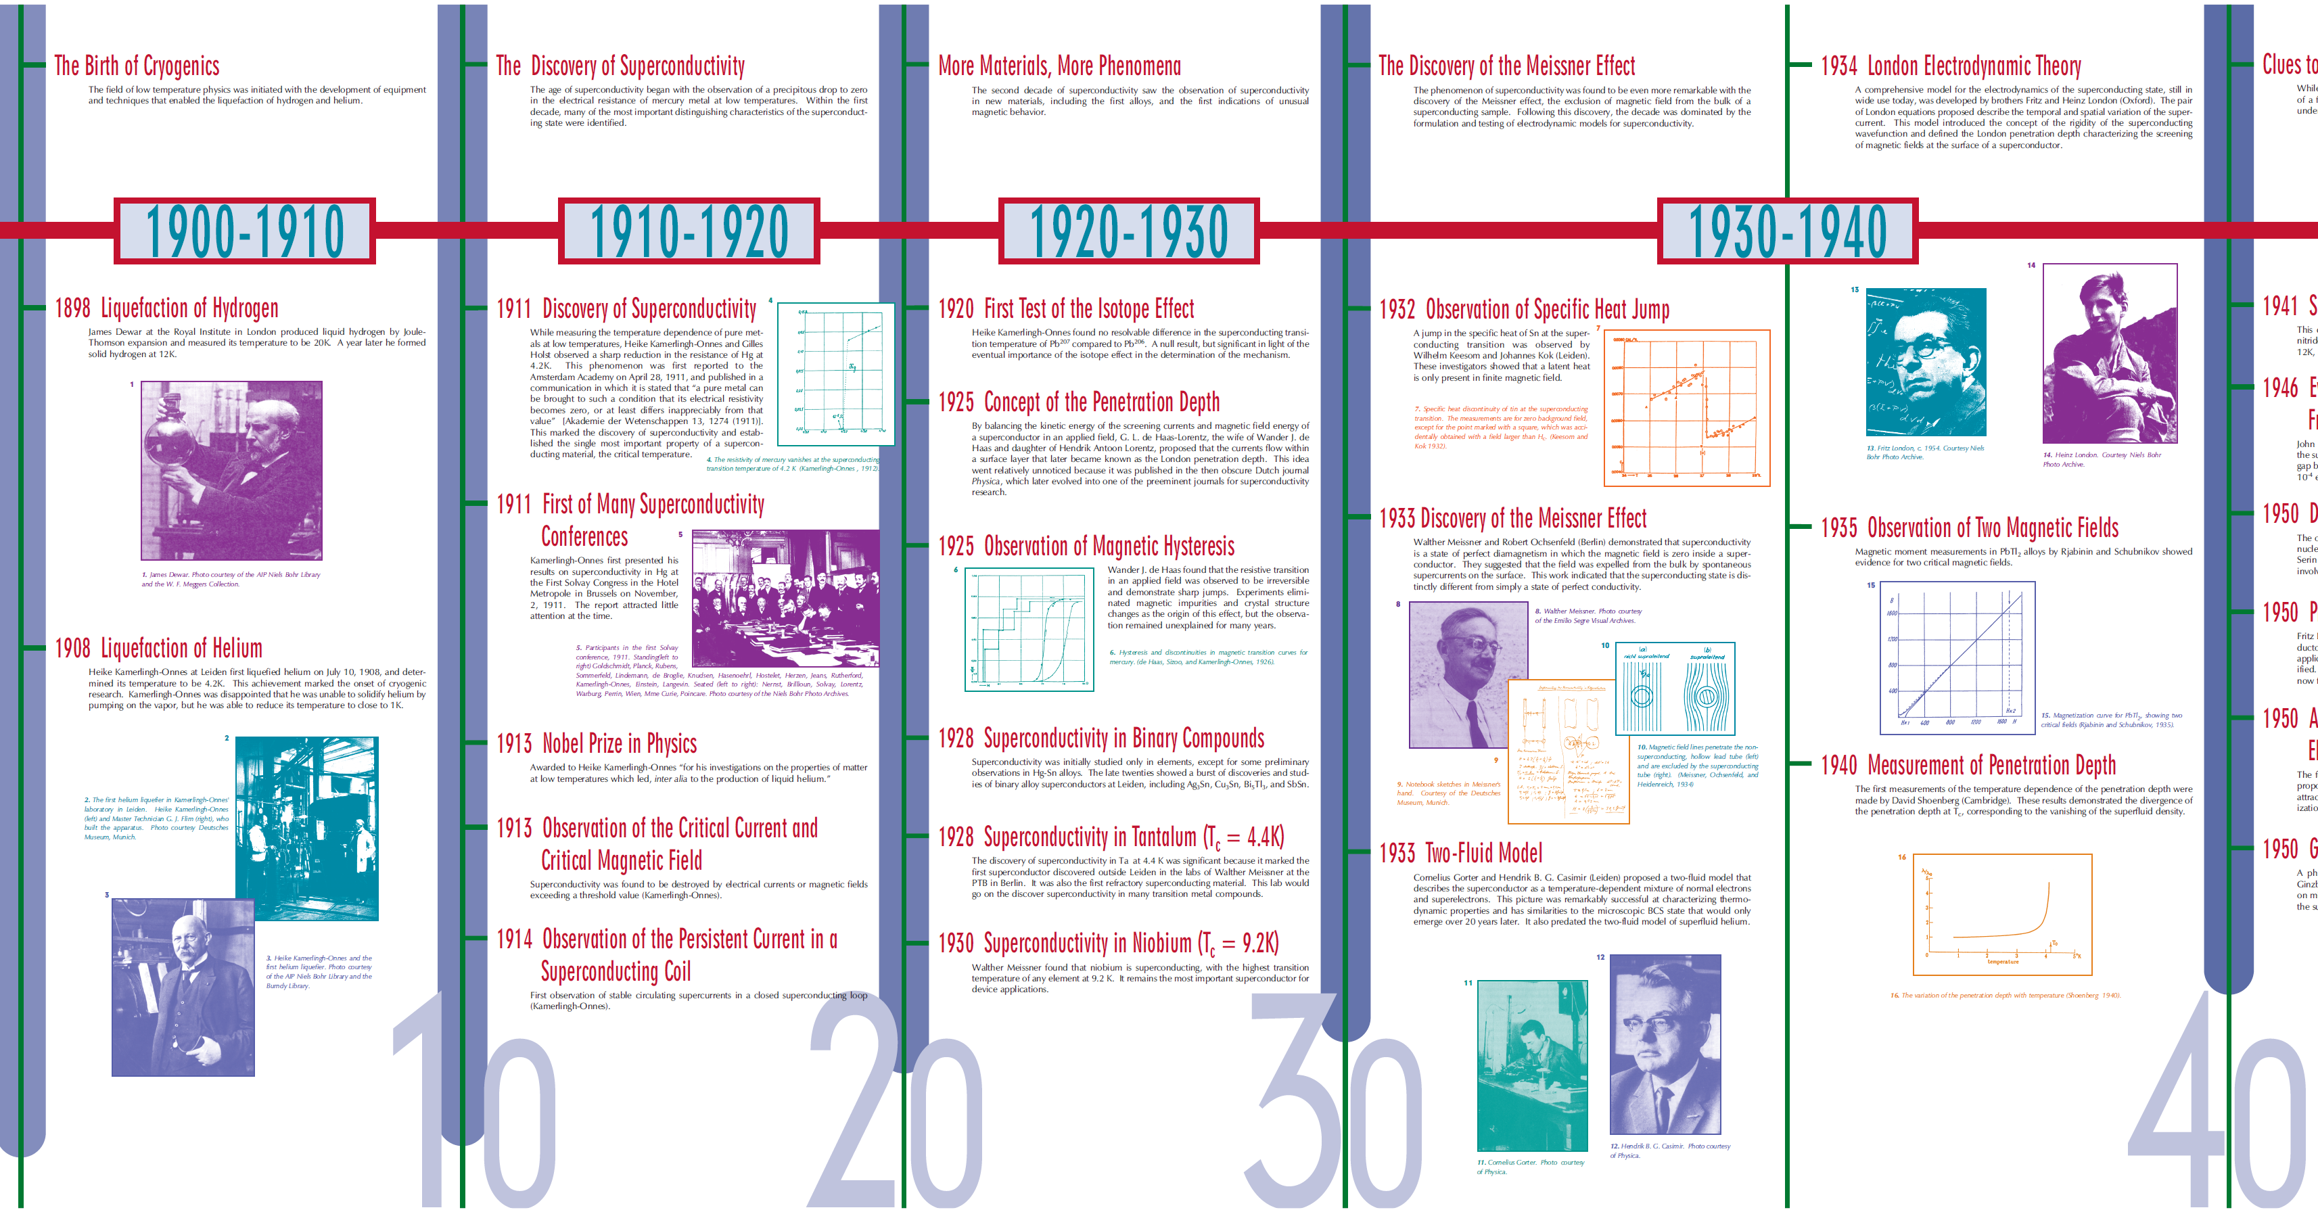
The HISTORY of SUPERCONDUCTIVITY and SUPERCONDUCTOR DEVICES (1911-1940)

Slide 2
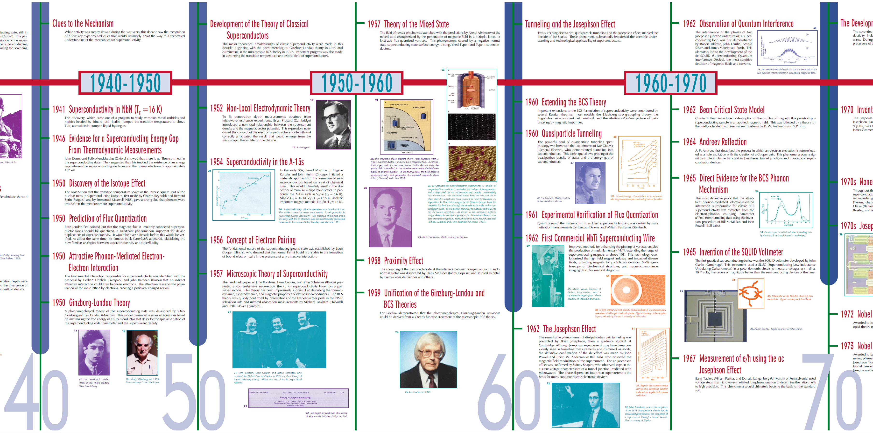
The HISTORY of SUPERCONDUCTIVITY and SUPERCONDUCTOR DEVICES (1940-1970)

Slide 3
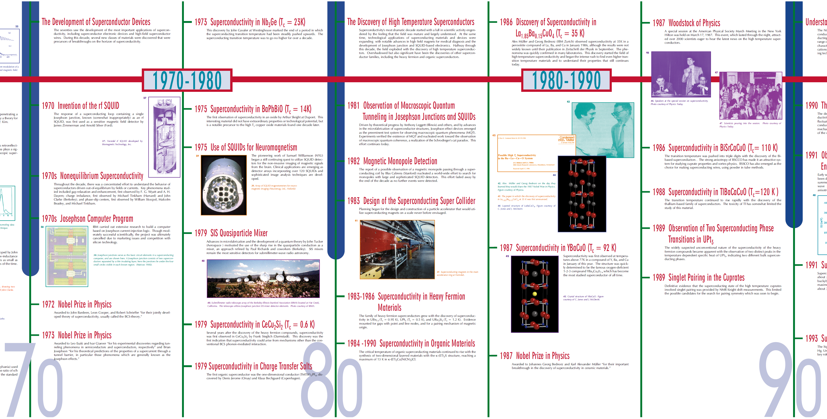
The HISTORY of SUPERCONDUCTIVITY and SUPERCONDUCTOR DEVICES (1940-1970)

Slide 4
The HISTORY of SUPERCONDUCTIVITY and SUPERCONDUCTOR DEVICES (1990-2019)
Since 2000 …

